Slide 1
Data Mining
Week4 Lecture 1 Part 3

Slide 2
Support Vector Machines
Find a linear hyperplane (decision boundary) that will separate the data
Notes:
Figure 5.21 shows a plot of a data set containing examples that belong to
two different classes, represented as squares and circles. The data set is also
linearly separable; i.e., we can find a hyperplane such that all the squares
reside on one side of the hyperplane and all the circles reside on the other

Slide 3
Support Vector Machines
One Possible Solution

Slide 4
Support Vector Machines
Another possible solution

Slide 5
Support Vector Machines
Other possible solutions

Slide 6
Support Vector Machines
Which one is better? B1 or B2?
How do you define better?
Notes:
Although their training errors are zero, there is no guarantee
that the hyperplanes will perform equally well on previously unseen examples.
The classifier must choose one of these hyperplanes to represent its decision
boundary, based on how well they are expected to perform on test examples.

Slide 7
Support Vector Machines
Find hyperplane maximizes the margin => B1 is better than B2
Maximal margin Classifier
Notes:
To get a clearer picture of how the different choices of hyperplanes affect the
generalization errors, consider the two decision boundaries, B1 and B2, shown
in Figure 5.22. Both decision boundaries can separate the training examples
into their respective classes without committing any misclassification errors.
Each decision boundary Bi is associated with a pair of hyperplanes, denoted
as bi1 and bi2, respectively. bi1 is obtained by moving a parallel hyperplane
away from the decision boundary until it touches the closest square(s), whereas
bi2 is obtained by moving the hyperplane until it touches the closest circle(s).
The distance between these two hyperplanes is known as the margin of the
classifier. From the diagram shown in Figure 5.22, notice that the margin for
B1 is considerably larger than that for B2. In this example, B1 turns out to
be the maximum margin hyperplane of the training instances.

Slide 8
Support Vector Machines
Notes:
A linear SVM is a classifier that searches for a hyperplane with the largest
margin, which is why it is often known as a maximal margin classifier. To
understand how SVM learns such a boundary, we begin with some preliminary
discussion about the decision boundary and margin of a linear classifier.

Slide 9
Linear SVM
Linear model:
Learning the model is equivalent to determining the values of
How to find from training data?
Notes:
Consider a binary classification problem consisting of N training examples.
Each example is denoted by a tuple (xi, yi) (i = 1, 2, . . . , N), where xi =
(xi1, xi2, . . . , xid)T corresponds to the attribute set for the ith example. By
convention, let yi ∈ {−1, 1} denote its class label. The decision boundary of a
linear classifier can be written in the following form:
w · x + b = 0, (5.28)
where w and b are parameters of the model.

Slide 10

Learning Linear SVM
Objective is to maximize:
Which is equivalent to minimizing:
Subject to the following constraints:
or
This is a constrained optimization problem
Solve it using Lagrange multiplier method
$$y_{i}(w•x_{i}+b)≥1, i=1,2,...,N$$

Slide 11
Example of Linear SVM
Support vectors

Slide 12
Learning Linear SVM
Decision boundary depends only on support vectors
If you have data set with same support vectors, decision boundary will not change
How to classify using SVM once w and b are found? Given a test record, x_{i}

Slide 13
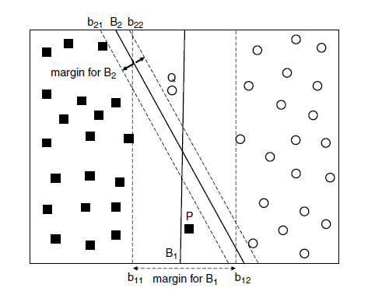
Non-Linearly Separable
Notes:
B1 should still be preferred over B2 because it
has a wider margin, and thus, is less susceptible to overfitting. However, the
SVM formulation presented in the previous section constructs only decision
boundaries that are mistake-free. This section examines how the formulation
can be modified to learn a decision boundary that is tolerable to small training
errors using a method known as the soft margin approach. More importantly,
the method presented in this section allows SVM to construct a linear decision
boundary even in situations where the classes are not linearly separable. To
do this, the learning algorithm in SVM must consider the trade-off between
the width of the margin and the number of training errors committed by the
linear decision boundary.

Slide 14
Support Vector Machines
What if the problem is not linearly separable?

Slide 15
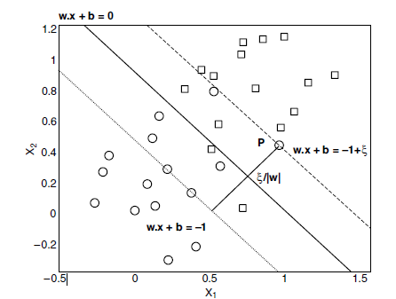
Soft Margin
Notes:
Thus, ξ provides an estimate of the error of the decision boundary
on the training example P.

Slide 16
Support Vector Machines
What if the problem is not linearly separable?
Introduce slack variables
Need to minimize:
Subject to:
If k is 1 or 2, this leads to similar objective function as linear SVM but with different constraints (see textbook)
Notes:
Eita >0 should be
In principle, we can apply the same objective function as before and impose
since there are no constraints on the number of mistakes the decision boundary
can make, the learning algorithm may find a decision boundary with a very
wide margin but misclassifies many of the training examples, as shown in
Figure 5.27. To avoid this problem, the objective function must be modified
to penalize a decision boundary with large values of slack variables. The
modified objective function is given by the following equation:
the conditions given in Equation 5.45 to find the decision boundary. However,

Slide 17
Support Vector Machines
Find the hyperplane that optimizes both factors

Slide 18
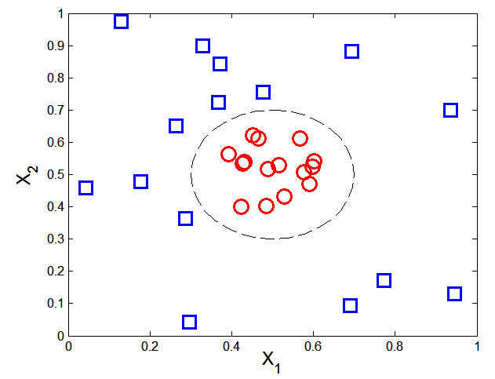

Nonlinear Support Vector Machines
What if decision boundary is not linear?

Slide 19
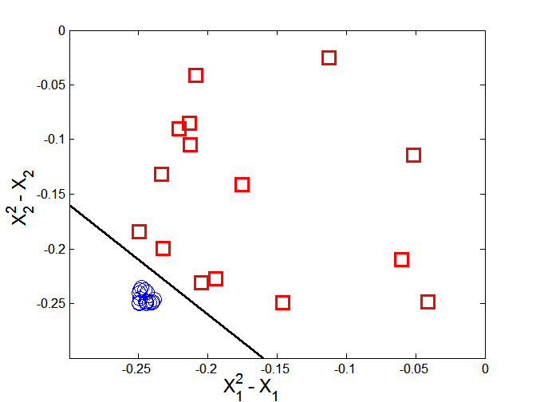



Nonlinear Support Vector Machines
Transform data into higher dimensional space
Decision boundary:

Slide 20
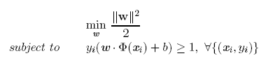

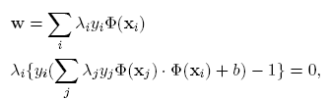

Learning Nonlinear SVM
Optimization problem:
Which leads to the same set of equations (but involve Φ(x) instead of x)

Slide 21
Characteristics of SVM
The learning problem is formulated as a convex optimization problem
Efficient algorithms are available to find the global minima
Many of the other methods use greedy approaches and find locally optimal solutions
High computational complexity for building the model
Robust to noise
Overfitting is handled by maximizing the margin of the decision boundary,
SVM can handle irrelevant and redundant attributes better than many other techniques
The user needs to provide the type of kernel function and cost function
Difficult to handle missing values
What about categorical variables?

